Slide 1

ACHARYA
Learning Solutions
Software Training Solutions
BN Reddy Nagar, Hyderabad

Slide 2
About Us
Acharya Learning Solutions is a premier training institute located in BN Reddy Nagar, Hyderabad.
We offer comprehensive software training programs designed to equip students and professionals with the skills required to excel in the IT industry.

Slide 3
Our Internships
1. AIML
2. Blockchain
3. Java Full Stack
4. Python Full Stack
5. React and React Native (Mobile)
6. AWS DevOps
7. Azure DevOps
8. MS SQL Server Administration
9.Testing Tools (Selenium)
Note: Training followed by Application Development

Slide 4
Our Training Programs
1. AIML
2. Blockchain
3. Java Full Stack Development
4. Python Full Stack Development
5. React & React Native(Mobile)
6. SQL (MySQL or MS SQL or MongoDB)
7. AWS DevOps
8. Azure DevOps
9. MS SQL Server Administration
10.Testing Tools (Selenium)

Slide 5
Upcoming Courses
1. SAP All Functional Modules
2. DBA
3. Workday

Slide 6
Java Full Stack Development
Core Java
Backend Technologies (Spring, Hibernate)
Frontend Technologies
(HTML, CSS, JavaScript, React)
Database (MySQL, MS SQL)
Cloud Computing (AWS)

Slide 7
Python Full Stack Development
Core Python
Web Technologies (Django or Flask)
Frontend Technologies
(HTML, CSS, JavaScript, React)
Database (MySQL, MS SQL)
Cloud Computing (AWS)

Slide 8
React & React Native(Mobile)
Basics of HTML, CSS, JS
Introduction to React
Components and Props
State and Lifecycle
Handling Events
Conditional Rendering
Lists and Keys
Forms
Lifting State Up
Composition vs Inheritance

Slide 9
SQL (MySQL or MS SQL)
- Introduction to Databases
- SQL Basics
- Advanced SQL Queries
- Database Design
- Stored Procedures and Functions
- Database Administration
- Performance Tuning

Slide 10
AWS DevOps
Our AWS DevOps course covers:
Introduction to AWS
AWS CloudFormation
AWS EC2
AWS S3
AWS Lambda
AWS RDS
CI/CD Pipeline
Monitoring and Logging
Infrastructure as Code

Slide 11
MS SQL Server Administration
Installation and Configuration
Security Management
Backup and Recovery
Performance Tuning
High Availability
Monitoring and Maintenance
Troubleshooting

Slide 12
Testing Tools (Selenium)
Introduction to Automation Testing
Selenium WebDriver
TestNG Framework
Page Object Model
Data-Driven Testing
Continuous Integration with Jenkins
Selenium Grid

Slide 13
Our Clients
Tumma Technologies
Drillio AI, India
PWS, India
Matech Solutions, USA

Slide 14
Our Colleges
MS Institute of Technology
Lords Institute Of Engineering & Technology
MVS Engineering College
Habeeb College of Engineering & Technology

Slide 15
Our Projects
Junior Eats Application
Customers (Mobile Application)
Schools (Web Application)
Restaurants (Web Application)
Website:
www.jreats.com

Slide 16
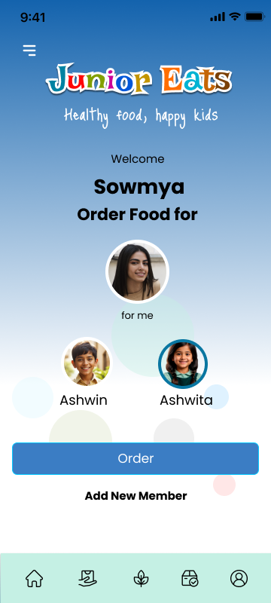
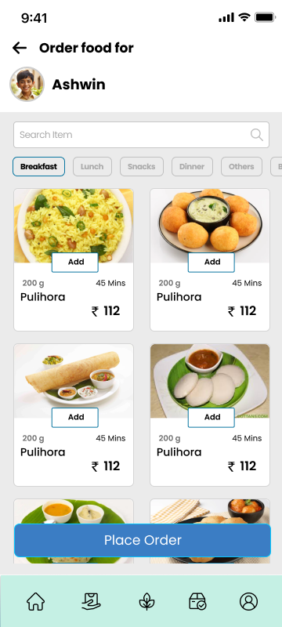

Slide 17
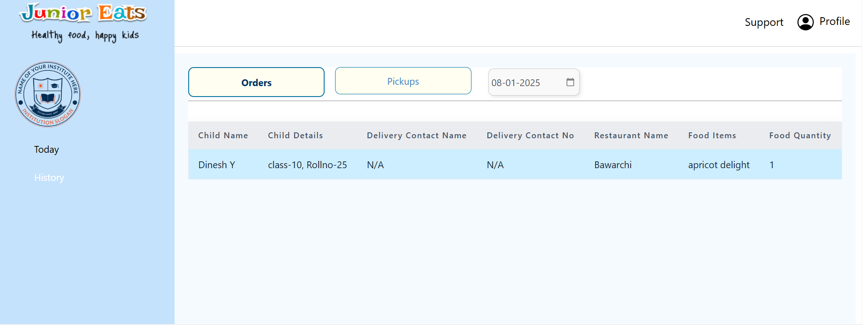

Slide 18
TECHNOLOGIES
DATABASES: My SQL, MongoDB
API: Python 3, Flask, Django
INTEGRATIONS: Two-factor (SMS), RazorPay, Google Integration, Firebase
FRONTEND: HTML5, CSS3, Bootstrap, React, Node.js
MOBILE TECH: React Native, Android Studio, IOS
GEN-AI: OpenAI Integration
DEVOPS: Linux, AWS Cloud, Jenkins
QA: Jira, Selenium, Postman

Slide 19
Under Development
Cloud Consulting
Cloud Learning

Slide 20


Nithin A
Fullstack Developer
B Tech (CSE)
2020-2024
Neeraj T
Fullstack Developer
B Tech (CSE)
2020 - 2024
Edukondal G
Frontend Developer
B Tech (ECE)
2018-2022
Rajasri S
Fullstack Developer
BSC (Computers)
2021-2024
Archita G
Fullstack Developer
B Tech (ECE)
2020-2024
Maheshwari Reddy S
Devops Engineer
B Tech (EEE)
2016-2020

Slide 21
Contact Us
Acharya Learning Solutions
Address : Road No 4, BN Reddy Nagar, Hyderabad - 070
Email : contact@acharyals.com
Phone : +91 814 225 1234
Website : www.acharyals.com

